Slide 1
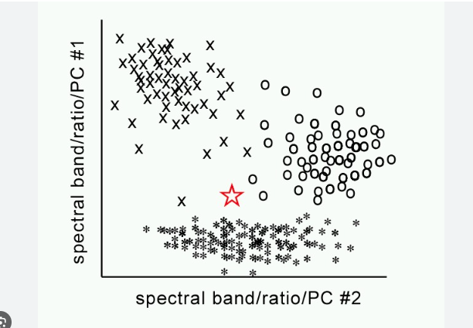
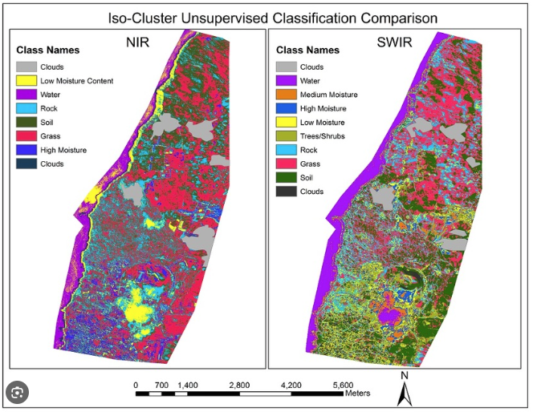
Unsupervised Image Classification

Slide 2
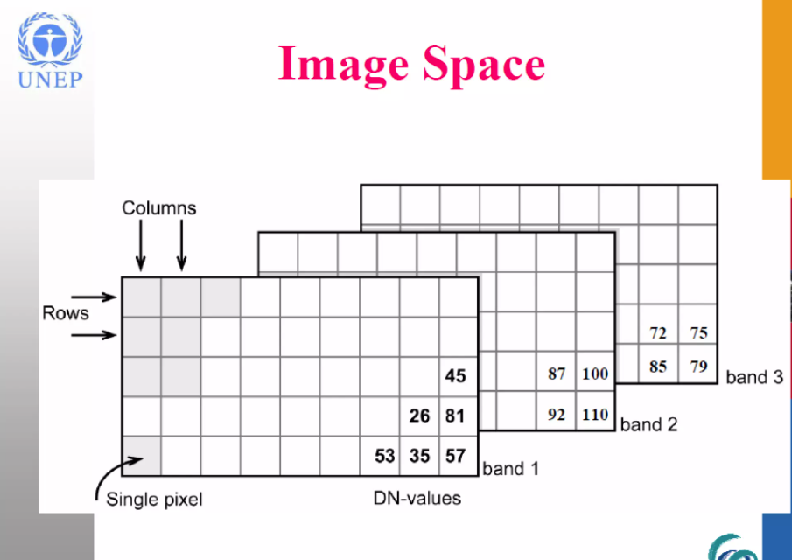
Structure of the image
Structured in rows and columns
Have several spectral bands, depending with the characteristics of the sensor
Each pixel has a Digital Number (DN) value
DN values range from 0-255
Each pixel is square – spatial resolution

Slide 3
Understanding DN Values
In remote sensing, DN value refers to the Digital Number value. It is a term commonly used to describe the numerical representation of the brightness or radiance of a pixel in a digital image.
When electromagnetic energy is captured by a remote sensing sensor, it is converted into digital form using an analog-to-digital converter
The DN value typically ranges from 0 to a maximum value, which depends on the bit depth of the sensor.
DN values close to 0 means low radiance or reflectance e.g water bodies, shadows – close to 255 means high reflectance snow areas, clouds, metal objects, buildings

Slide 4
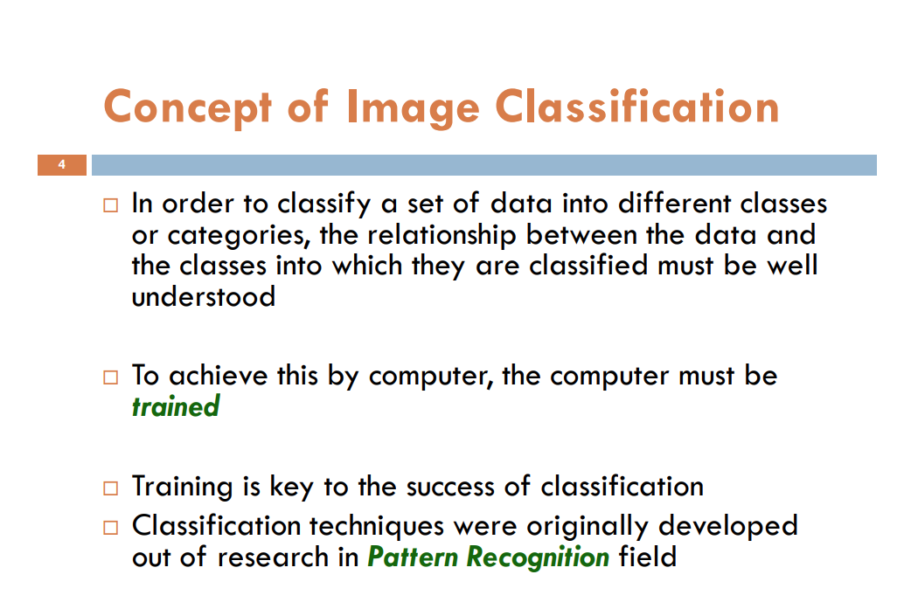

Slide 5
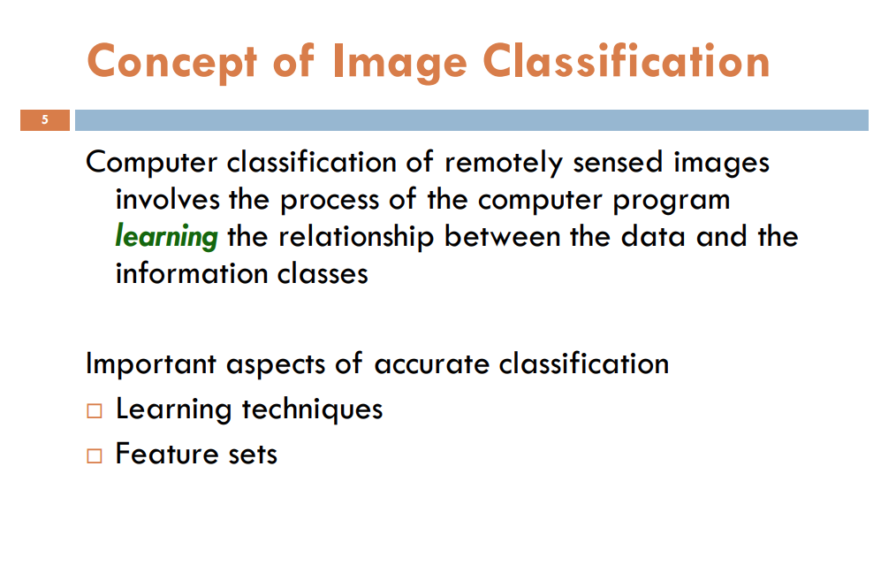

Slide 6
Classification in Remote Sensing
Classification in remote sensing refers to the process of categorizing or assigning land cover or land use classes to pixels or image objects within a remotely sensed image
It involves grouping similar pixels or objects based on their spectral, spatial, or temporal characteristics, allowing for the identification and mapping of different features on the Earth's surface.

Slide 7
Classification is used to “smooth” out small variations in an image and to simplify it into a Land cover “map” *This is termed spectral pattern recognition.

Slide 8
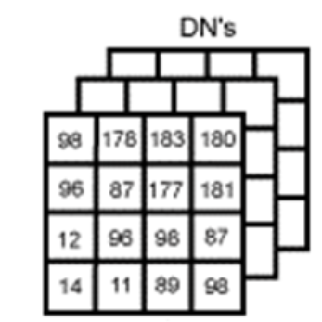
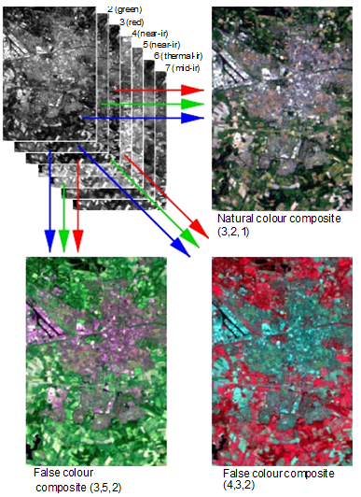
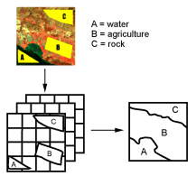

Slide 9
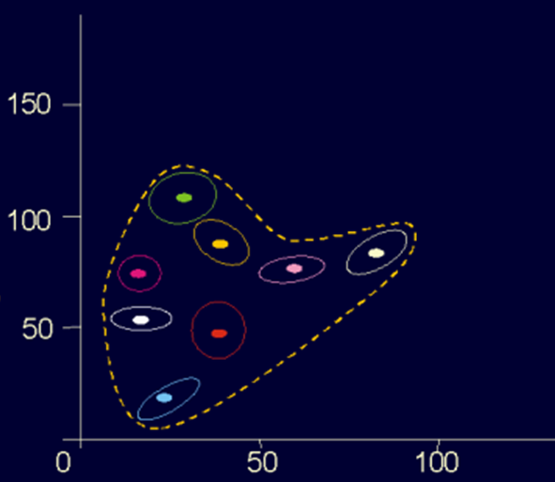
Green arable land
Pasture
Deciduous forest
Coniferous forest
Bare soil
Harvested arable land
Town / village
Water

Slide 10
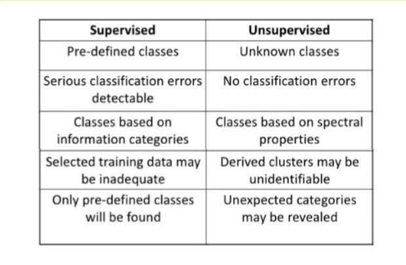
Types of Image classification in RS
Unsupervised Image Classification
Supervised Image Classification

Slide 11
Define unsupervised classification
When access to domain knowledge or the experience of an analyst is missing, the data can still be analyzed by numerical exploration, whereby the data are grouped into subsets or clusters based on statistical similarity

Slide 12
Basic principles of Unsupervised Classification
The process requires a minimal amount of initial input from the analyst
A numeric operation searches for natural grouping of the spectral properties of pixels
The analyst determines the information class for each spectral class after the spectral classes are formed
Understand the spectral/radiometric & spatial characteristics of the sensor
Has to translate spectral classes into information classes

Slide 13
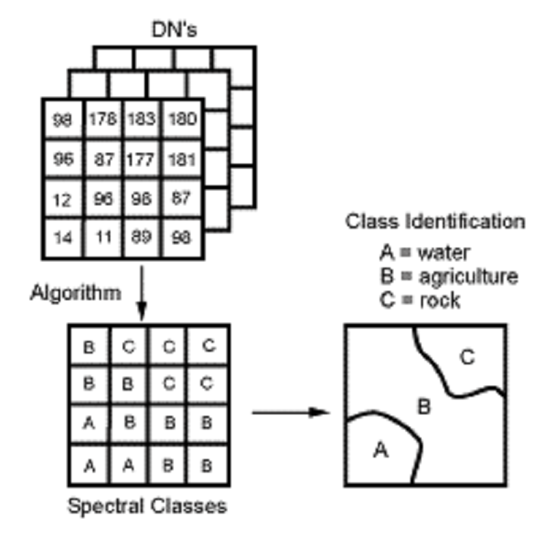
Unsupervised Classification
Spectral classes are first grouped by the computer, based solely on the numerical information in the data by “cluster algorithms”, which determines natural groupings in the data.
The analyst then matches these classes to their appropriate information (ground cover) classes.

Slide 14
Steps in unsupervised classification
Statistical Clustering
Data Distribution Analysis
Cluster Formation
Determining the Optimal Number of Clusters
Cluster Interpretation
Post-Classification Refinement
Accuracy Assessment

Slide 15
Unsupervised classification algorithms
In the absence of reliable training data it is possible to understand the structure of the data using statistical methods such as clustering algorithms.
Popular clustering algorithms are k-means and ISODATA
All feature vectors are points in an L-dimensional space where L is the number of bands (The letter K is reserved for the number of clusters!)
Members of a cluster are more similar to each other than to members of another cluster –

Slide 16
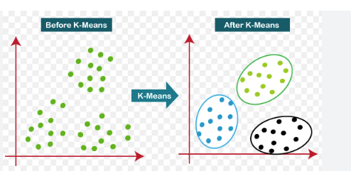
K-Means clustering
Iterative algorithm
Number of clusters K is known by user
Most popular clustering algorithm
Initialize randomly K cluster mean vectors
Assign each pixel to any of the K clusters based on minimum feature distance
After all pixels are assigned to the K clusters, each cluster mean is recomputed.
Iterate till cluster mean vectors stabilize

Slide 17
ISODATA ALGORITHM
Iterative Self-Organizing Data Analysis Technique
Developed in biology in the 1960’s by Ball and Hall
User specific parameters for ISODATA
Minimum and maximum size of cluster
Maximum intra-cluster variance
Minimum separation between pairs of clusters
Maximum and minimum number of clusters

Slide 18
Advantages & Disadvantages of Unsupervised Classification
Advantages
-No extensive prior knowledge of the region is required.
-Objectivity - human error is minimized.
-Unique classes are recognized as distinct units - even if they have small spatial extent.
Disadvantages
- Spectrally distinct classes are identified that do not always correspond to information categories.
- Limited control over identity of classes, e.g. to match other classification schemes

